Slide 1

1
CircuitGuard - PCB Defect Detection and Classification Application
- KAVYA S

Slide 2
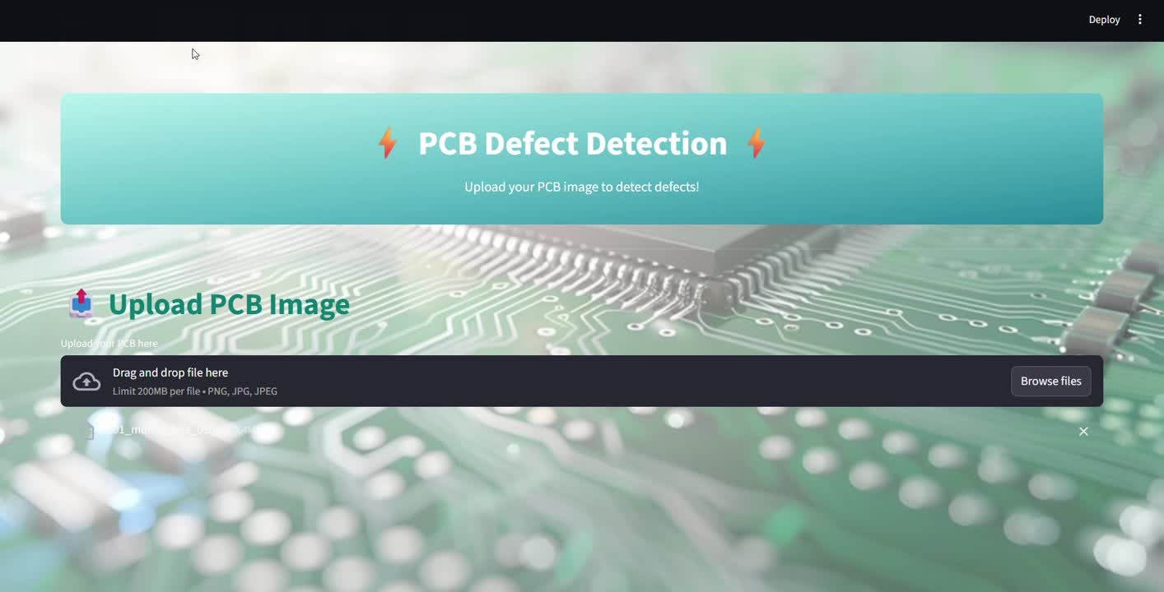
2

Slide 3
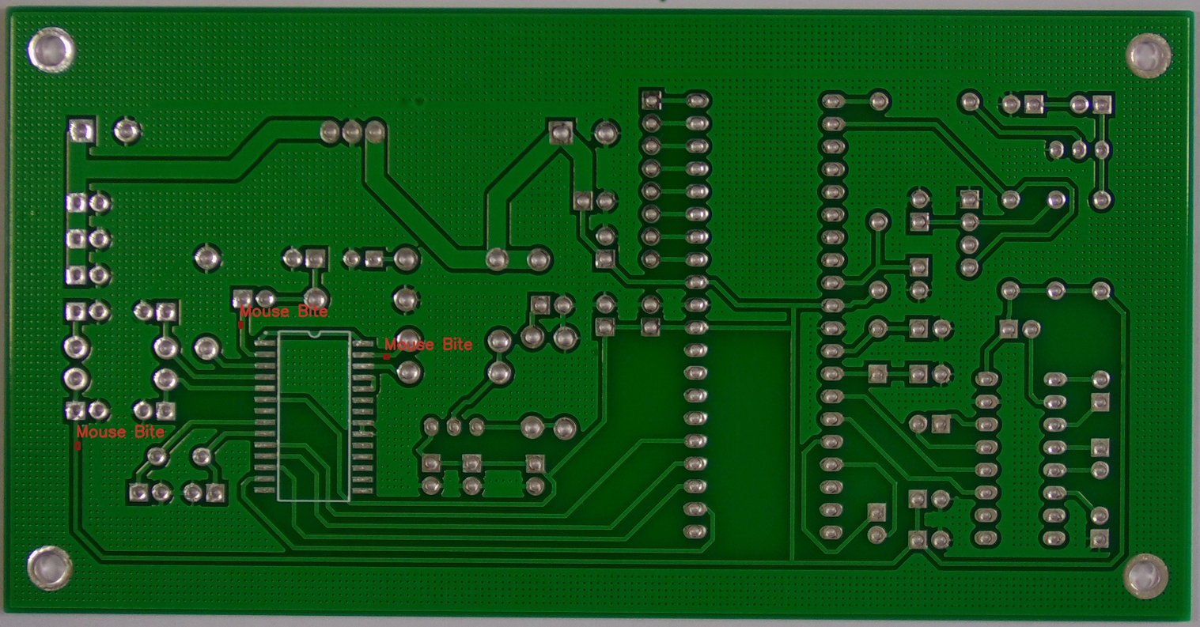
3
Introduction
Overview:
Printed Circuit Boards (PCBs) are prone to defects that affect the reliability and performance of electronic devices.
Manual inspection is slow, error-prone, and not scalable for mass production.
This project develops an automated defect detection system combining image processing and deep learning, specifically using EfficientNet-B4.
The workflow includes image subtraction, ROI extraction, model training, evaluation, and frontend integration to deliver accurate results in real-time.
Key Features:
High accuracy (~97%) in classifying multiple defect types.
Real-time predictions via a Streamlit UI, making it user-friendly for non-technical users.
Generates annotated outputs with bounding boxes and defect labels.

Slide 4
4
Image Subtraction
Objective: Identify defect regions by comparing reference and test images.
Image Subtraction:
Loaded reference (template) and defected PCB images.
Aligned images to ensure pixel-level correspondence.
Subtracted the reference from the defected image to highlight areas of difference, representing potential defects.
Thresholding and Enhancement:
Applied Gaussian blur to reduce noise in the difference map.
Used Otsu’s thresholding to convert the difference map into a clear binary mask.
The processed image shows highlighted defect regions, ready for ROI extraction.

Slide 5
5
ROI Extraction
Objective: Extract defect regions to create a dataset for model training.
Contour Detection:
Applied OpenCV contour detection to find connected regions in the thresholded difference map.
Filtered out small and noisy contours to ensure only relevant defects were captured.
Excluded contours touching the image borders to avoid background or alignment noise (not part of the PCB).
Bounding Boxes and Cropping:
Generated bounding boxes around valid contours.
Cropped ROIs from the defected image corresponding to each bounding box.
Dataset Preparation:
Labeled ROIs according to defect types (missing hole, mouse bite, short, etc.).
Stored ROI information in a CSV file, mapping each ROI image to its label.

Slide 6
6
Model Training
Objective: Train EfficientNet-B4 model to classify defect types.
Data Preparation:
Resized ROIs to 128×128 pixels for consistency.
Applied normalization to standardize pixel values and improve model stability during training.
Training Process:
Split dataset into training and test sets (70% training, 30% testing)
Optimized using Adam optimizer and Cross-Entropy Loss.
Monitored training loss and validation accuracy over epochs.
Early stopping applied to avoid overfitting.
Reached accuracy ~98.4% during the training process.

Slide 7
7
Model Testing
Objective: Evaluate the trained model on unseen test ROIs.
Testing Process:
Used the reserved test dataset (30%) to evaluate how well the trained EfficientNet model generalizes to unseen defects.
Ran predictions on the test ROIs to compute overall accuracy.
Calculated class-wise precision, recall, and F1-score.
Performance Analysis:
Observed class-wise metrics to identify strengths and areas for improvement.
Checked predictions against true labels to ensure reliable classification across all defect categories.
Outcome:
Model achieved ~96.9% overall accuracy.
Predictions matched well with true labels, with minimal false positives or negatives.

Slide 8
8
Frontend Development
Objective: Create an interactive and user-friendly interface for PCB defect detection.
Streamlit UI:
Users can upload PCB images and view results in real-time, with outputs annotated with bounding boxes and defect labels.
Provides an option to download processed images for documentation and future reference.
Designed for ease of use, allowing even non-technical users to operate the system effortlessly.
Interactive and Responsive Interface:
Uploaded images are processed and results are displayed promptly, allowing users to verify defects efficiently.
The interface is intuitive and user-friendly, ensuring smooth navigation

Slide 9
9
Backend Inference Pipeline
Objective: Automate preprocessing, ROI extraction, and defect classification.
Automatic Processing:
Uploaded PCB images are automatically compared against preloaded reference images in the backend.
Uploaded images are preprocessed to enhance features and reduce noise.
Contours are detected and ROIs are extracted automatically.
Each ROI is classified using the trained EfficientNet-B4 model.
Annotated Output:
Results display bounding boxes and defect labels clearly.
The system generates annotated outputs for each uploaded image, allowing users to review detected defects clearly, even if processing takes a few seconds per image.

Slide 10
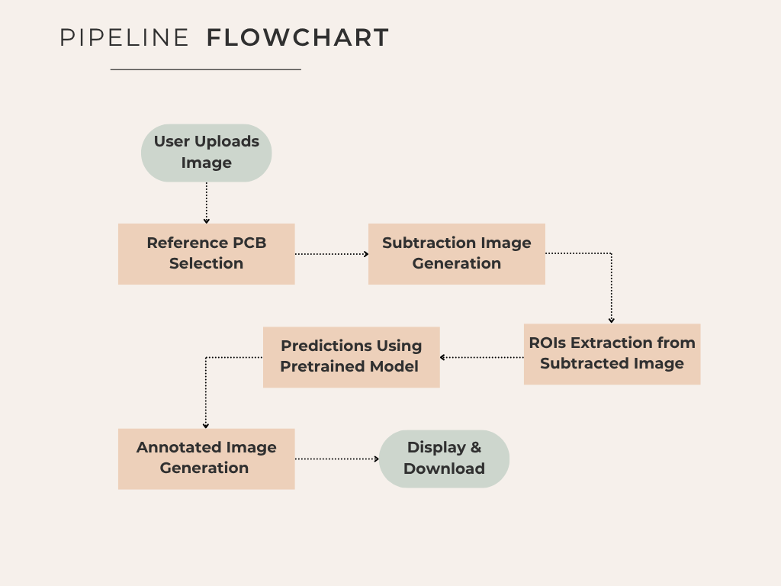
10

Slide 11
11
Thank You

